Slide 1

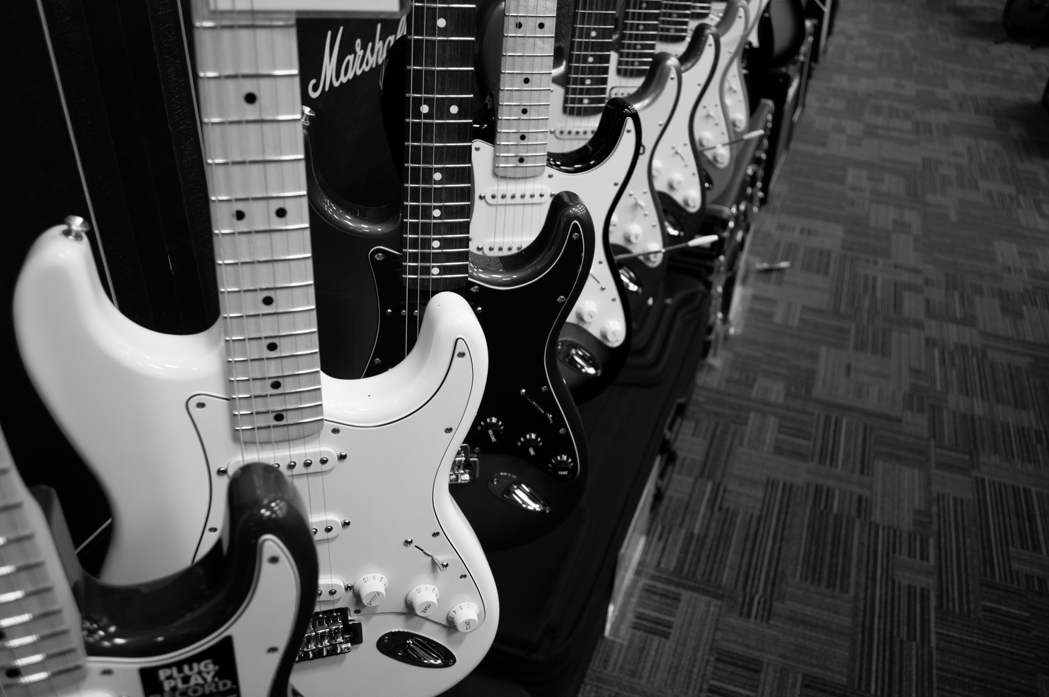



CHINOOK SALES PERFORMANCE ANALYSIS
by
Mohamed AbdEl-Nasser
Next Slide

Slide 2





BUSINESS OVERVIEW
Digital music store dataset
Tracks, artists, customers, and sales transactions
Goal: Identify key revenue drivers and trends

Slide 3
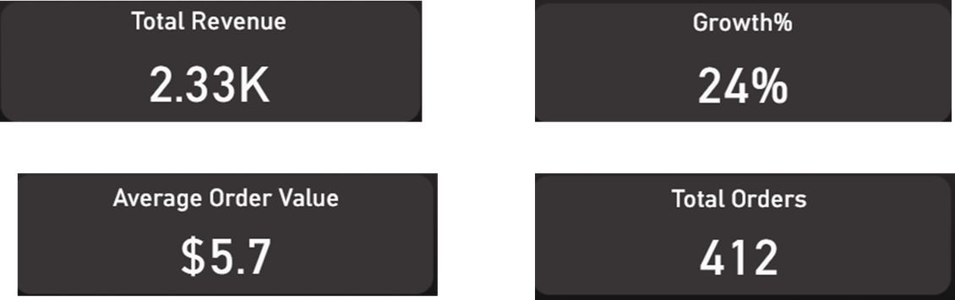
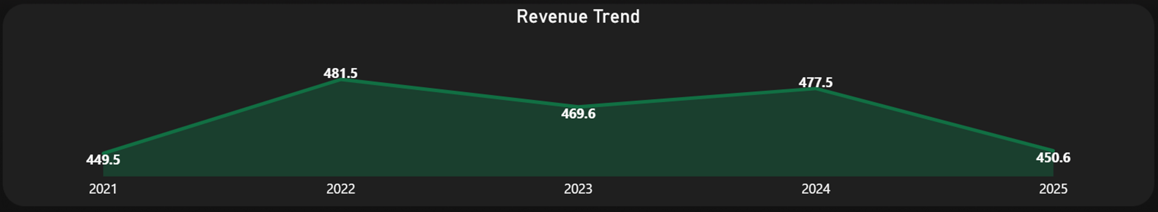
REVENUE OVERVIEW
Revenue remains stable over time
No strong growth trend
Consistent performance across periods

Slide 4
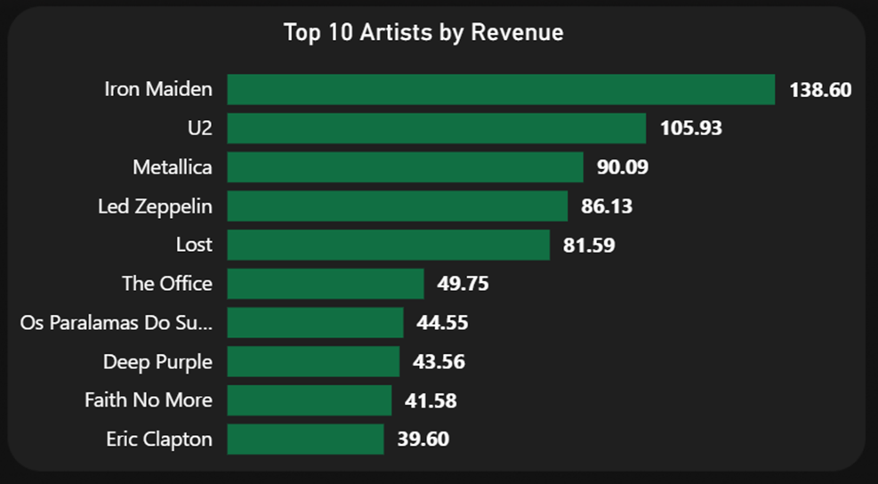
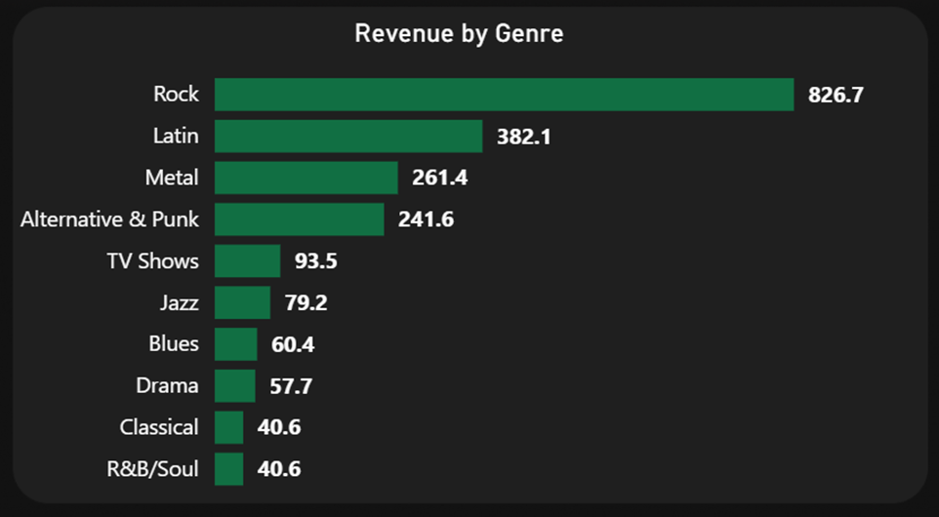
ARTIST & GENRE INSIGHTS
Top Performers
Top Artist: Iron Maiden
Top Genre: Rock
Followed by U2, Metallica and Led Zeppelin
Followed by Latin, Metal and Alt & Punk
Revenue is highly concentrated in few artists & genres

Slide 5
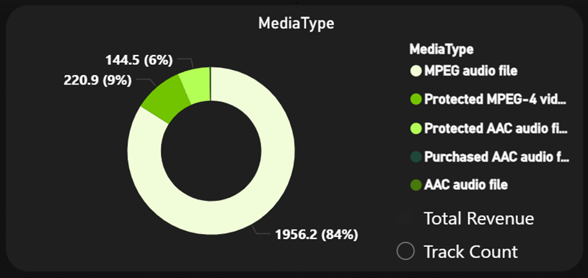
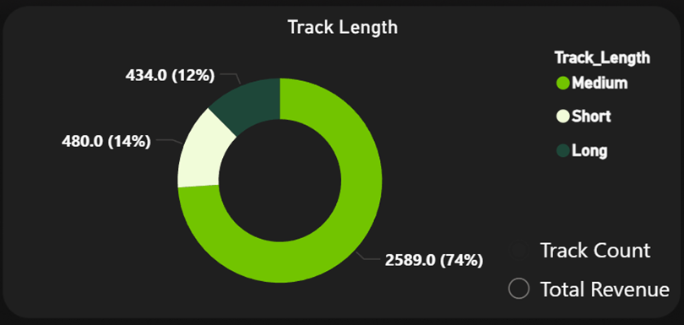
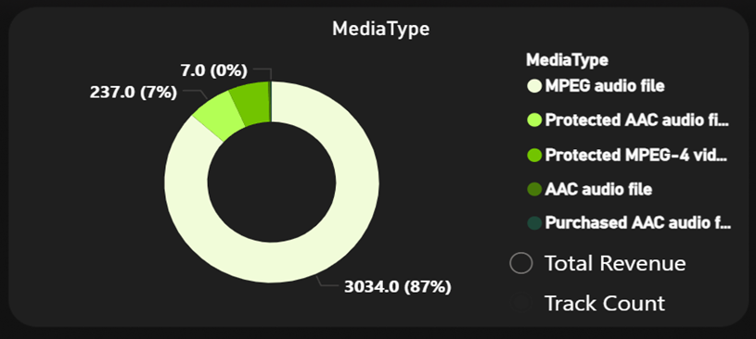
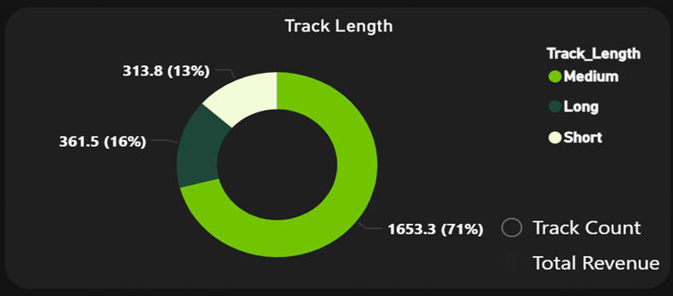
CATALOG INSIGHTS
Most tracks: MPEG audio format
Most tracks: Medium length (3–7 min)
Best-selling format: MPEG audio
Medium length tracks generate highest sales

Slide 6
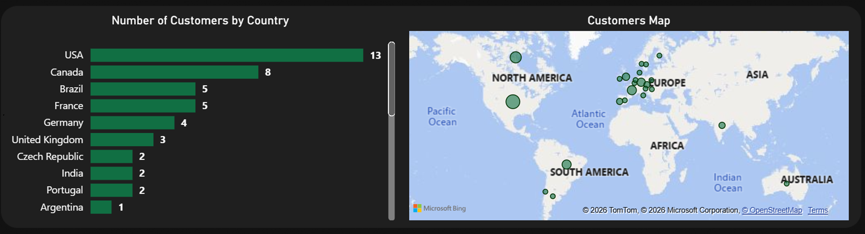
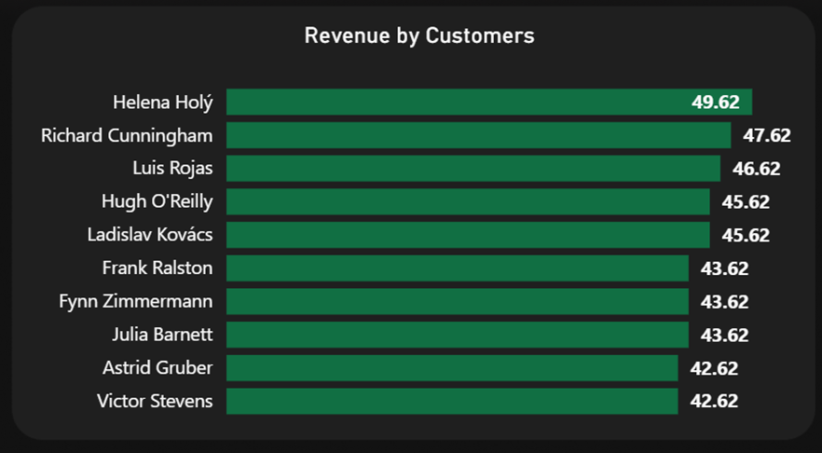
CUSTOMER & GEOGRAPHY
Top country: USA
Followed by: Canada, Brazil and France
Revenue concentrated in few regions

Slide 7
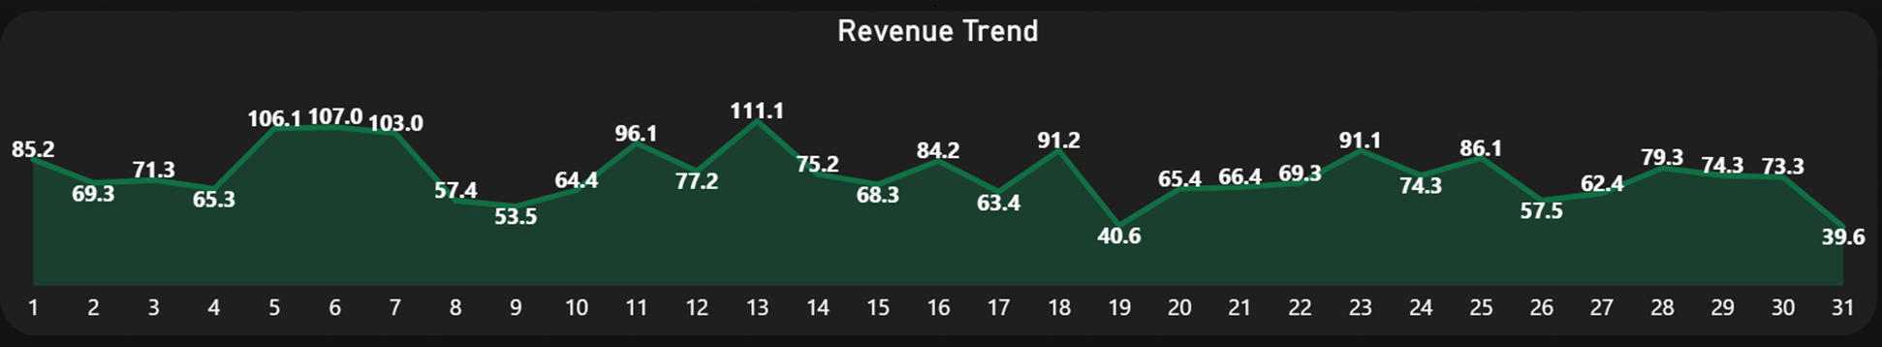
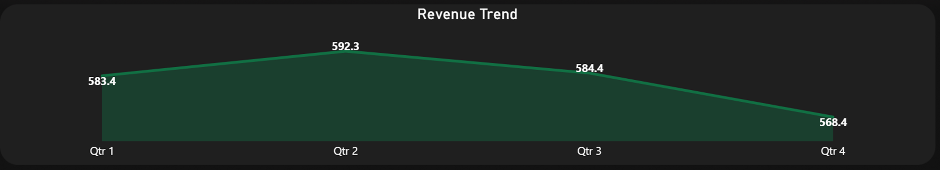
TIME PATTERNS
Sales peak mid-month & mid-year

Slide 8
KEY TAKEAWAYS
Revenue driven by Rock & top artists
Iron Maiden dominates catalog & sales
USA is the strongest market
Medium-length tracks perform best
Sales peak mid-month & mid-year

